Slide 1

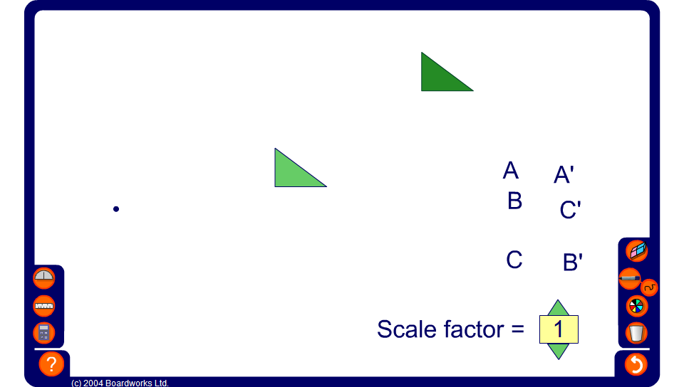


Exploring enlargement
Notes:
Use this activity to dynamically explore the relationship between the position of the centre of enlargement and the position of the image. Demonstrate examples where the centre of enlargement is inside the shape, on an edge or on a vertex.
Establish that the further the centre of enlargement is from the object the further the image is from the object.
Reveal the lengths of some of the sides and ask pupils to find the missing lengths.

